Slide 1

Social Science Research Design and Statistics, 2/e
Alfred P. Rovai, Jason D. Baker, and Michael K. Ponton
Evaluating Univariate Normality
PowerPoint Prepared by
Alfred P. Rovai
IBM® SPSS® Screen Prints Courtesy of International Business Machines Corporation,
© International Business Machines Corporation.

Slide 2
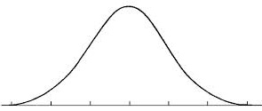
Evaluating Univariate Normality
Normality refers to the shape of a
variable’s distribution. A normally
distributed variable represents a
continuous probability distribution
modeled after the normal or Gaussian distribution, which means it is symmetrical and shaped like a bell-curve.
There are three types of normality: univariate, bivariate, and multivariate normality. Univariate normality applies to a single variable.
There are multiple tools available in SPSS to assist one in evaluating normality, e.g., inferential tests (Kolmogorov-Smirnov or Shapiro-Wilk), Q-Q plots, P-P plots, histograms, boxplots, and coefficients of skewness and kurtosis.

Slide 3
A smooth curve is referred to as a probability density curve (rather
than a frequency curve as one sees in the histogram of a small sample).
The area under any probability density curve is 1 because there is a 100% probability
that the curve represents all possible occurrences of the associated event.
The normal distribution is an example of a density curve. Therefore, for a normal distribution:
34.1% of the occurrences will fall between μ and 1σ
13.6% of the occurrences will fall between 1σ & 2σ
2.15% of the occurrences will fall between 2σ & 3σ

Slide 4
Normal Curve Characteristics
The normal distribution has the appearance of a bell-shaped curve.
Normal curves are unimodal and symmetric about the mean.
For a perfectly normal distribution, mean = median = mode = Q₂ = P₅₀
Normal curves are asymptotic to the abscissa (refers to a curve that continually approaches the horizontal x-axis but does not actually reach it until x equals infinity; the axis so approached is the asymptote).
Normal curves involve a large number of cases.

Slide 5
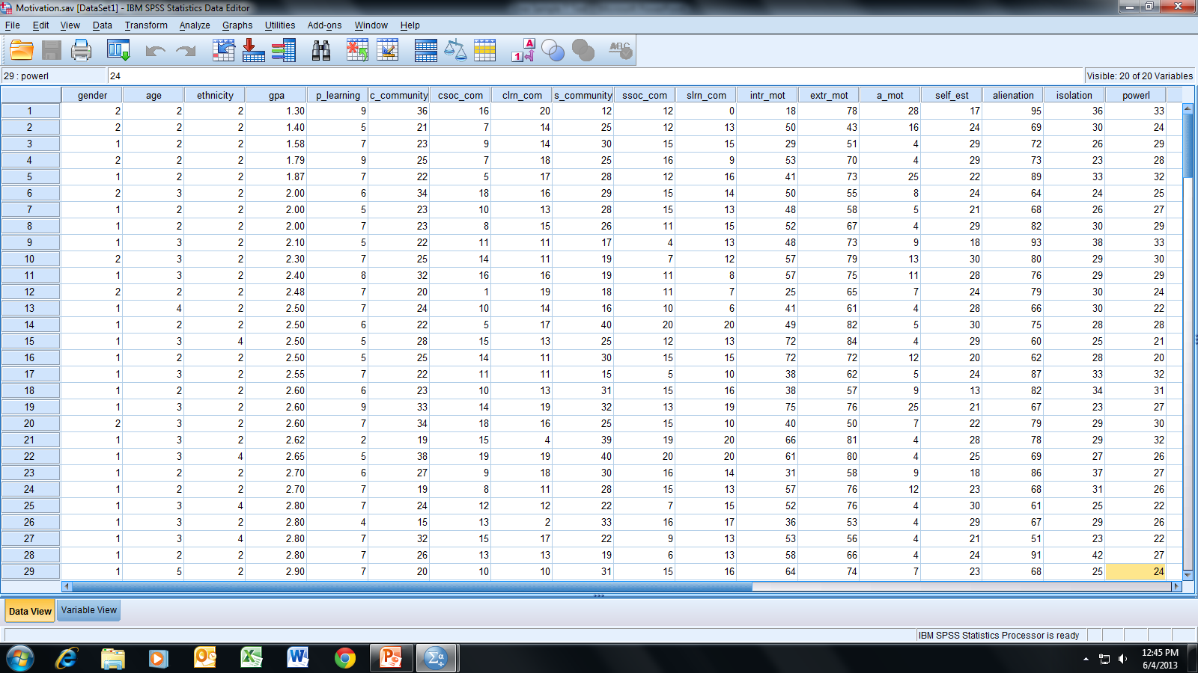
Open the dataset Motivation.sav.
File available at http://www.watertreepress.com/stats
TASK
Evaluate univariate normality for
powerlessness.

Slide 6
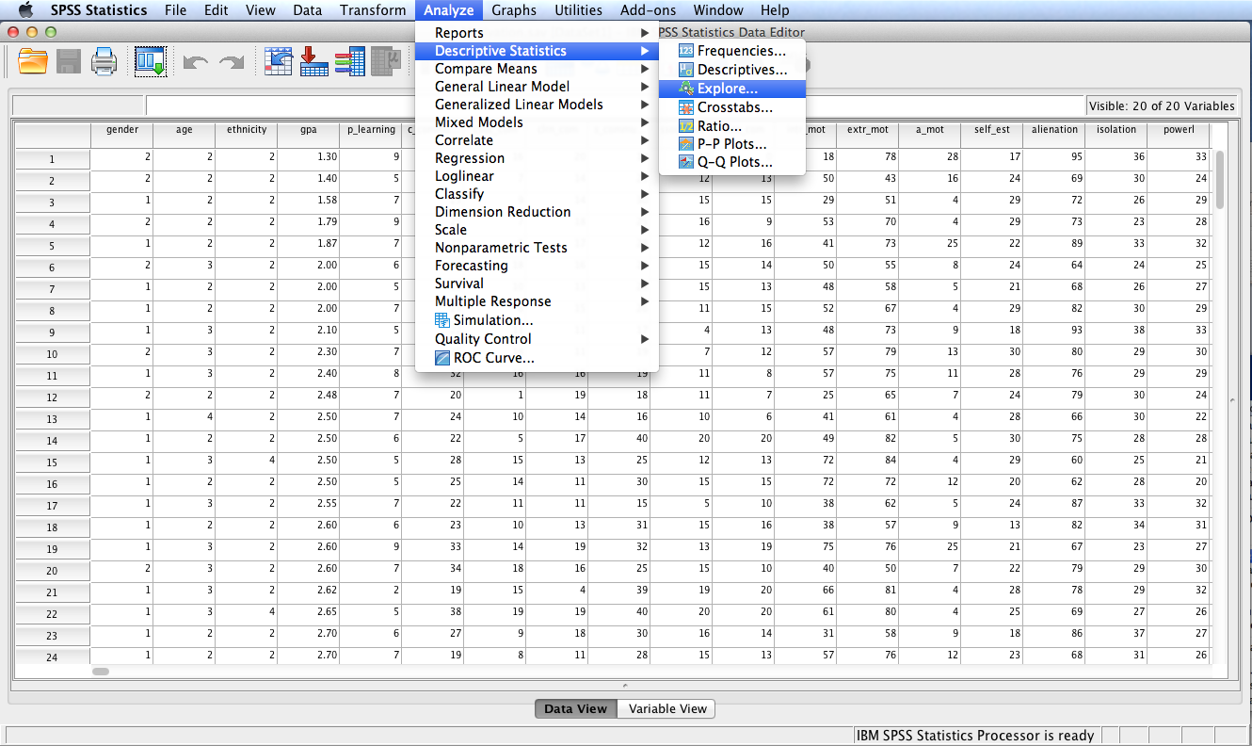
Follow the menu as indicated.

Slide 7
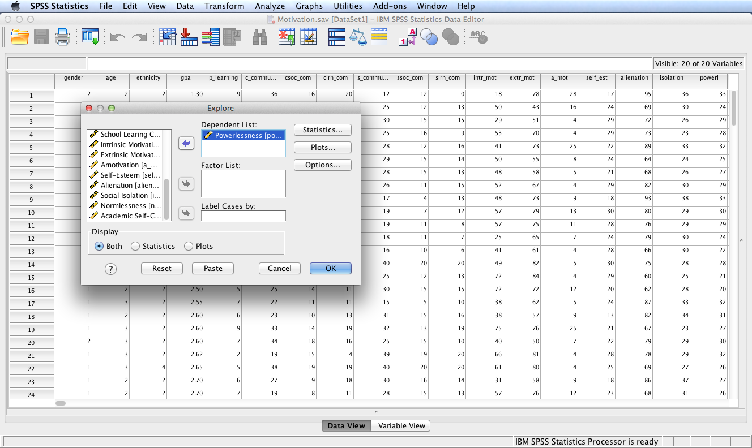
Move variable Powerlessness
(powerl) to the Dependent
List: box. Click the Plots…
button.

Slide 8
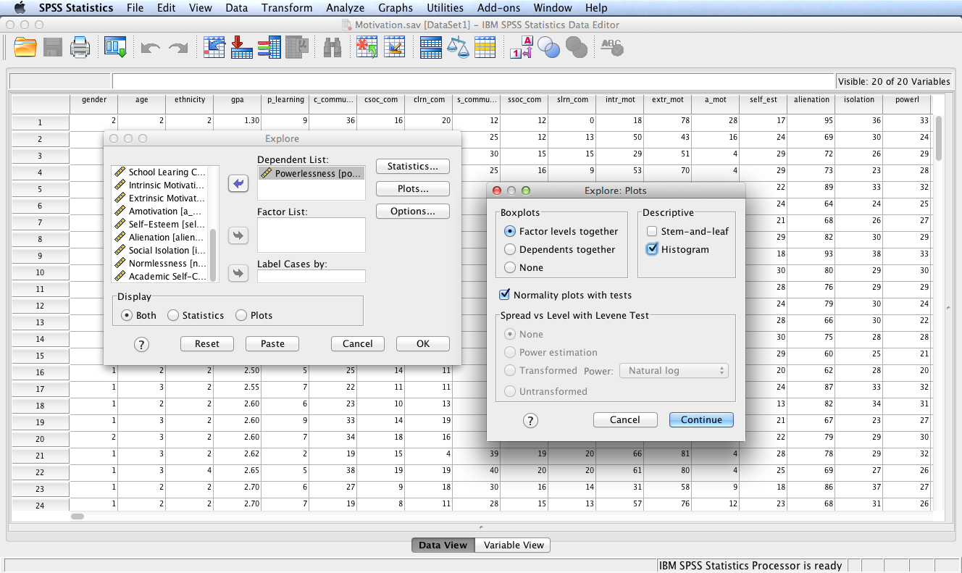
Check the Histogram box and the
Normality plots with tests box.
Click the Continue button and then
the OK button.

Slide 9
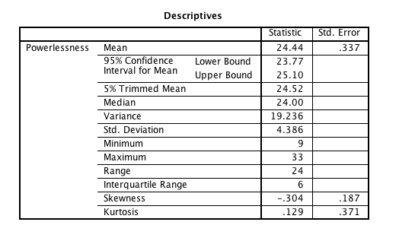
SPSS Output
The ratio of skewness to its standard error is used as a test of normality. If this ratio is < –2 or > +2, normality is not tenable. (Note: some researchers use a more stringent range of +1 to –1 as a standard for normality.)
In this example, the standard coefficient of skewness = –.304/.187 = –1.63 and the standard coefficient of kurtosis = .129/.371 = .35. The distribution does not vary greatly from normality, although skewness is an issue.

Slide 10
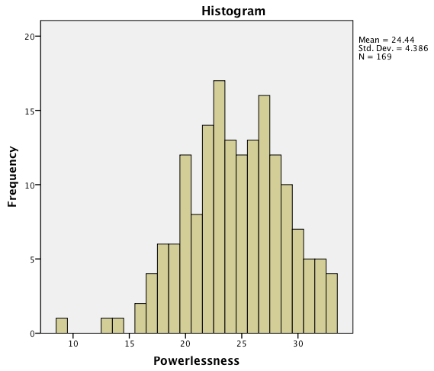
SPSS Output
The histogram confirms negative
skewness. However, the overall
appearance of the distribution
approximates a bell-shaped
normal distribution.

Slide 11
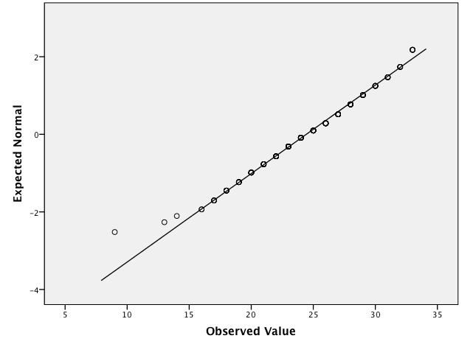
SPSS Output
This is a normal Q-Q plot of powerlessness.
If the data distribution approximates a normal
distribution, the plotted points will reflect
a straight line. Clearly there is an issue at the
lower end of the scale, consistent with the
negative skewness of the distribution.

Slide 12
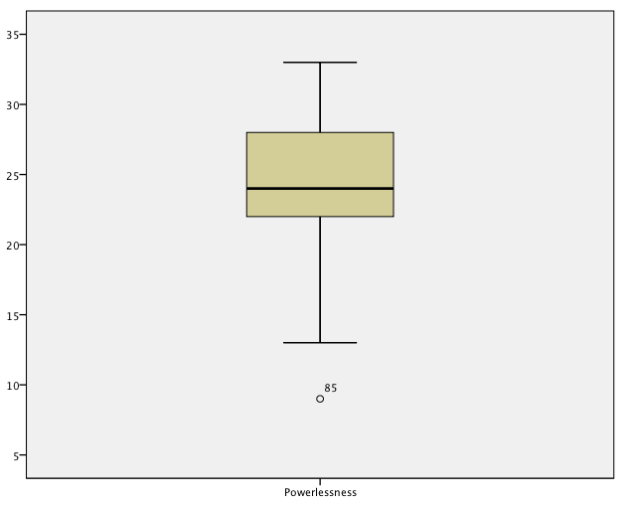
SPSS Output
This is a boxplot of powerlessness.
The negative skewness is also apparent in
this plot, to include the presence of a
mild negative outlier (case #85).

Slide 13
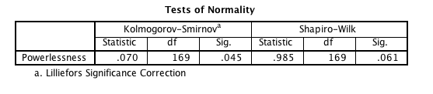
SPSS Output
Since N > 50, the Kolmogorov-Smirnov test the the appropriate statistical test to use to evaluate normality (i.e., use the Shapiro-Wilk test if N ≤ 50). This test evaluates the following null hypothesis: There is no difference between the distribution of powerlessness data and a normal distribution. Test results are significant, D(169) = .07, p = .045 (i.e., the p-value is less than α = .05), providing evidence to reject the null hypothesis. Consequently, it can be concluded that powerlessness scores are not normally distributed.
Note: the departure from normality is not severe and is mostly caused by the presence of case #85, the low outlier. One should verify that the data for case #85 is accurate and that case #85 is indeed a member of the target population. One may be able to tolerate the observed departure from normality if the intended parametric procedure is sufficiently robust to such departures from normality.

Slide 14
End of Presentation

